Slide 1
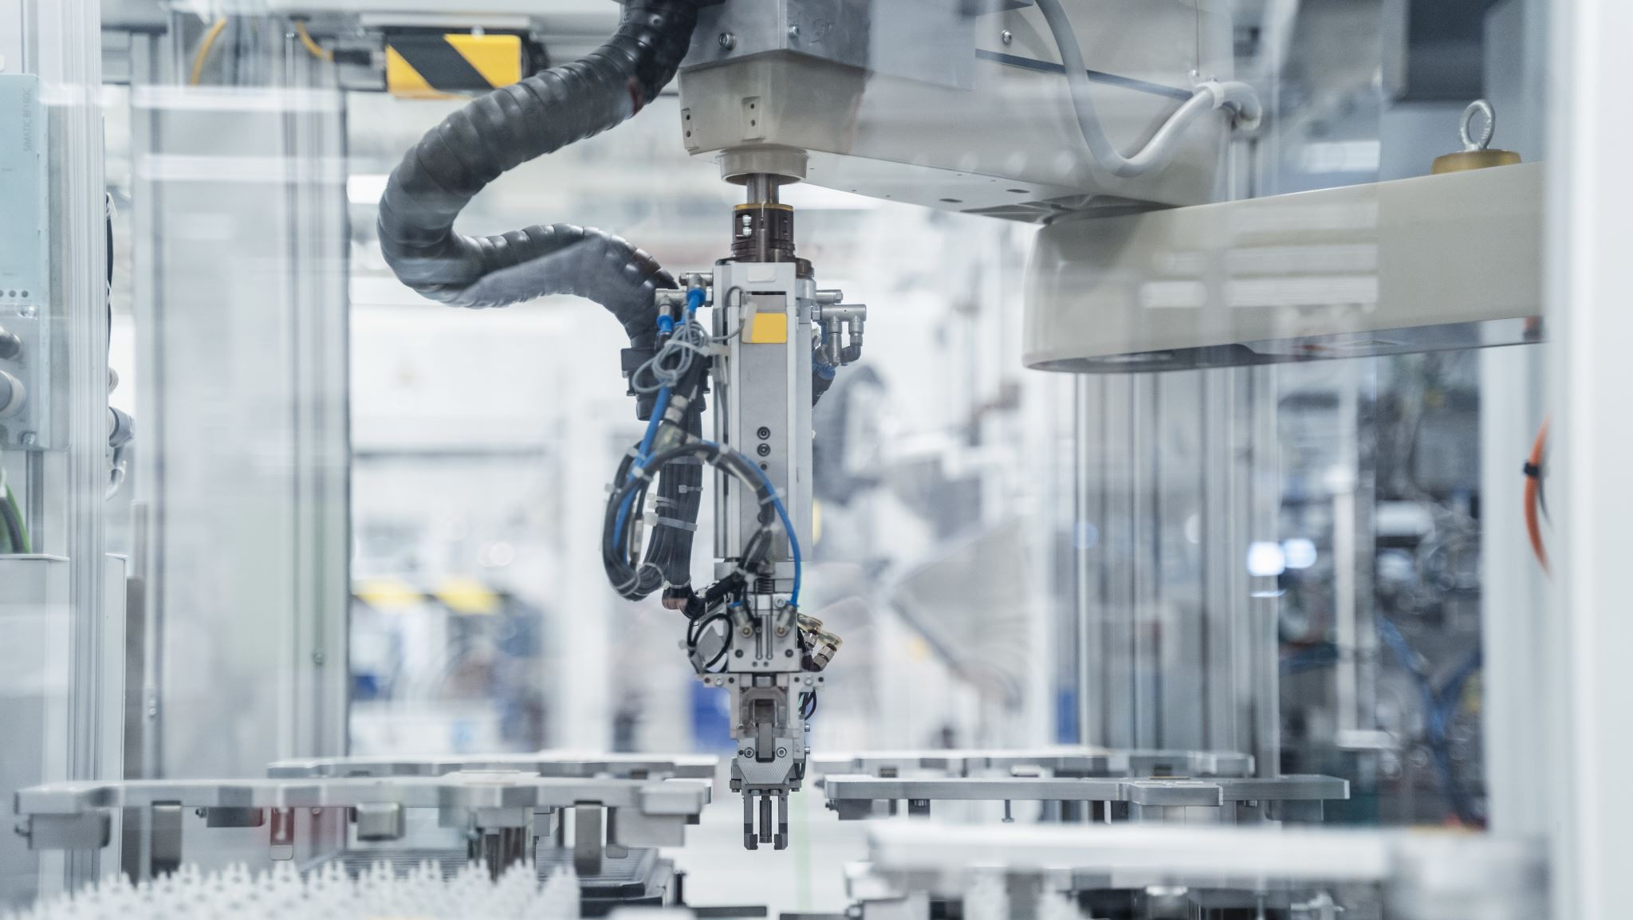
Predictive Maintenance of Machines using Machine Learning Algorithm
ADHARSH P
13-05-2024

Slide 2

INTRODUCTION
Predictive maintenance involves using data analysis, machine learning, and other techniques to predict when equipment failure is likely to occur so that maintenance can be performed just in time to prevent the failure.
Predictive maintenance is crucial for several reasons:
Cost savings: By preventing unexpected breakdowns and minimizing downtime, companies can save on repair costs and avoid production losses.
Increased uptime: Proactively addressing potential issues ensures that equipment operates smoothly, leading to higher productivity.
Enhanced safety: Predictive maintenance helps identify safety risks before they escalate into serious incidents, promoting a safer working environment.

Slide 3
OVERVIEW OF PREDICTIVE MAINTENANCE
Traditional Maintenance Approaches:
Reactive Maintenance:
Fixing equipment only after it breaks down.
Can lead to unexpected downtime, higher repair costs, and reduced productivity.
Preventive Maintenance:
Scheduled maintenance based on time or usage.
Helps prevent some breakdowns but can be inefficient and costly if performed too frequently or unnecessarily.
Predictive Maintenance:
Uses data analysis and machine learning to predict when maintenance is needed.
Allows for timely intervention before equipment failure, optimizing maintenance schedules and reducing costs.
Benefits of Predictive Maintenance:
Cost Savings:
Reduces unplanned downtime and emergency repairs, saving on repair costs and minimizing production losses.
Increased Uptime:
Ensures equipment operates at optimal levels, maximizing productivity and reducing disruptions to operations.
Improved Safety:
Identifies potential safety hazards before they escalate, enhancing workplace safety for employees and reducing the risk of accidents.
Enhanced Equipment Lifespan:
Allows for proactive maintenance, extending the lifespan of equipment and reducing the need for premature replacements.

Slide 4
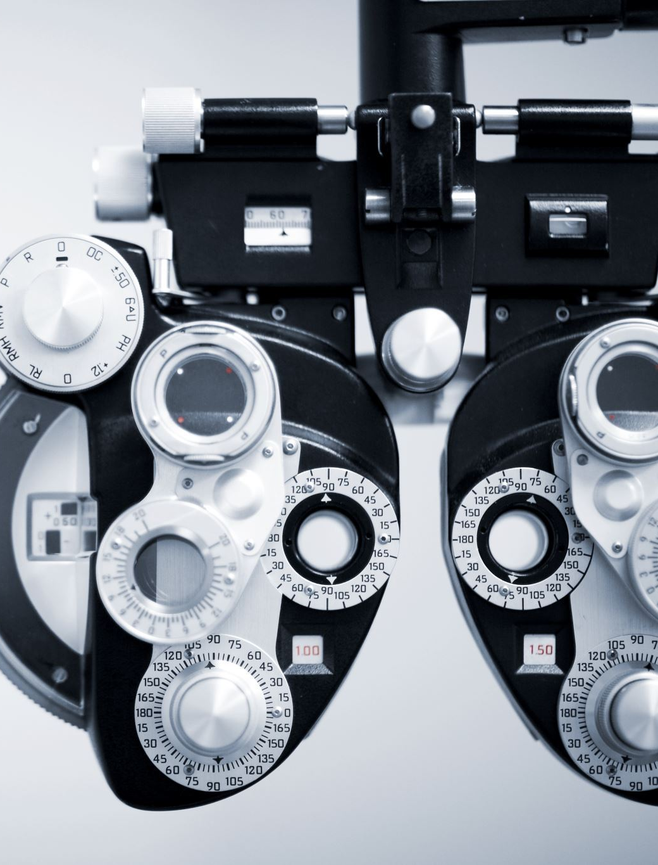
DATA SET OVERVIEW
UDI: Unique Device Identifier - a unique identifier for each device or unit in the dataset.
Product ID: Identifier for the type or model of the product being monitored.
Type: Type of product or machine being monitored (e.g., motor, compressor).
Air temperature [K]: The temperature of the air surrounding the machine in Kelvin.
Process temperature [K]: The temperature of the machine's internal process in Kelvin.
Rotational speed [rpm]: The speed at which the machine rotates, measured in revolutions per minute (rpm).
Torque [Nm]: The torque exerted by the machine, measured in Newton-meters (Nm).
Tool wear [min]: The cumulative amount of time the machine's tool has been in use, measured in minutes.
Target: The target variable indicating whether a failure occurred or not.
Failure Type: Type of failure that occurred, if any, categorized based on the failure mode.
The data contains 348 failure count and the rest 9652 as operational

Slide 5
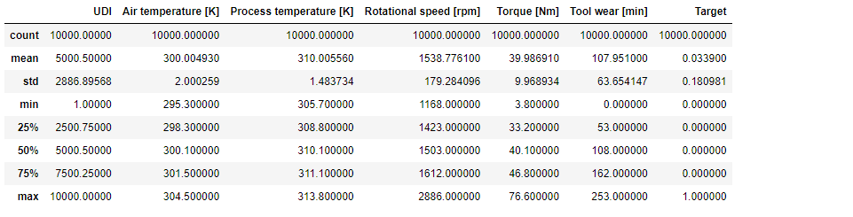
Summary statistics

Slide 6
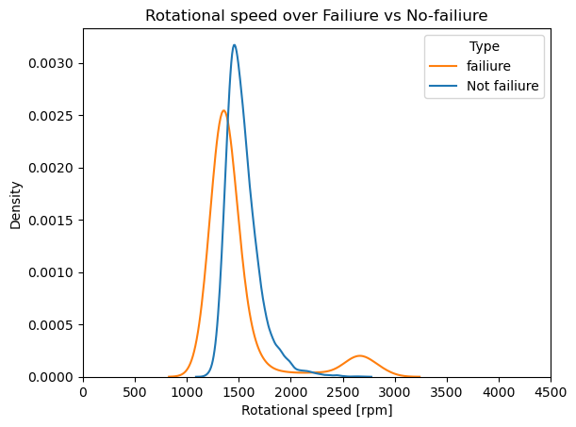
Rotational speed over failure vs non failure

Slide 7
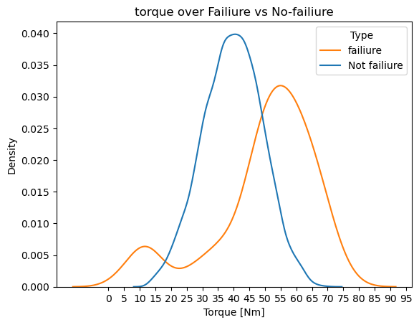
Torque over failure vs no failure

Slide 8
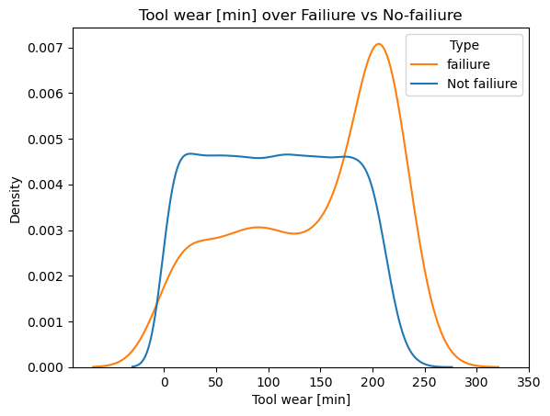
Tool wear[min] over Failure vs No- failure

Slide 9
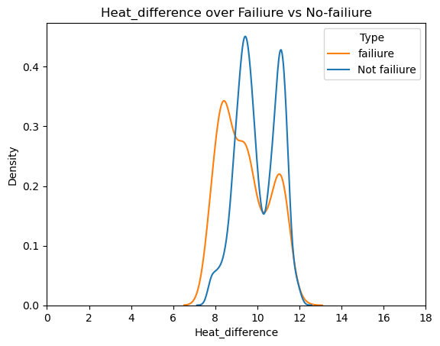
Heat difference over failure vs not failure

Slide 10
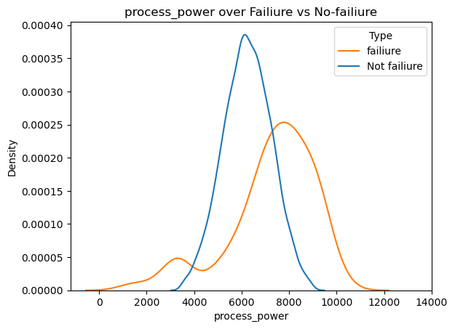
Process Power over failure vs no failure

Slide 11
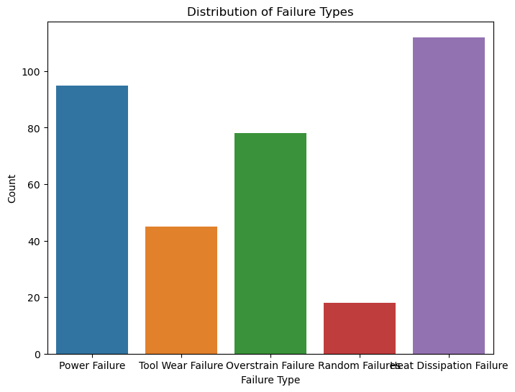
TYPES OF FAILURE

Slide 12
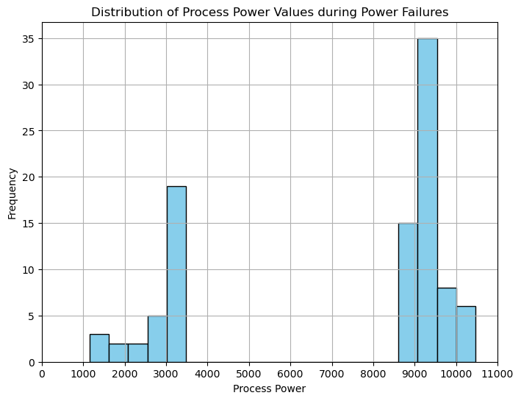
POWER FAILURE ANALYSIS
The product of torque and rotational speed (in rad/s) equals the power required for the process.
If this power is below 3500 W or above 9000 W, the process fails, which is the case 95 times in our dataset.

Slide 13
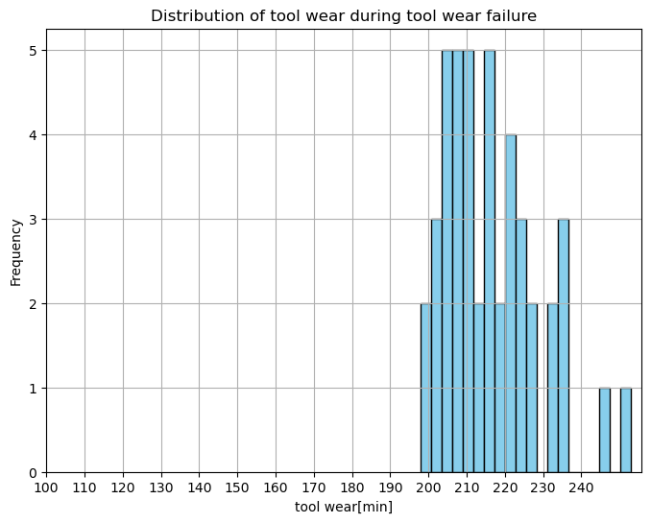
TOOL WEAR FAILURE ANALYSIS

Slide 14
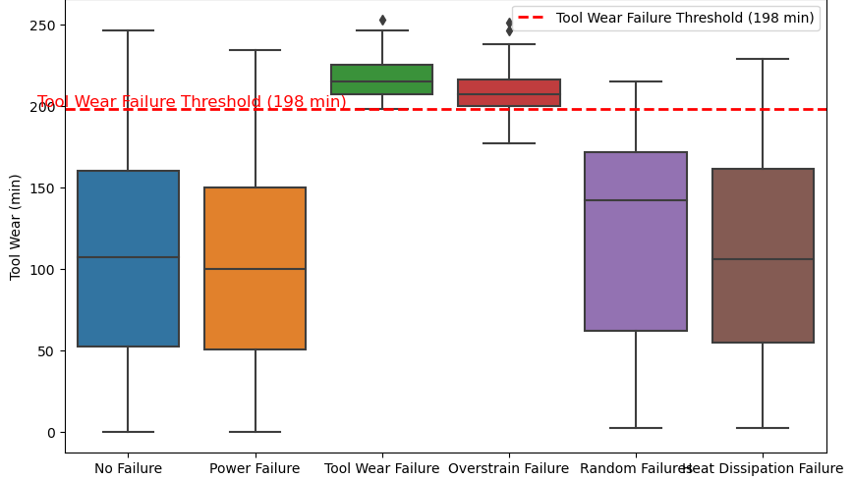

Slide 15
HEAT DISSIPATION FAILURE ANALYSIS
Heat dissipaton failiure takes place when the difference between air temperature and process temperage is very less and the rpm of the machine is very low to descipate the heat.
the difference between air- and process temperature is below 8.6 K and the tool’s rotational speed is below 1380 rpm. This is the case for 115 data points.

Slide 16
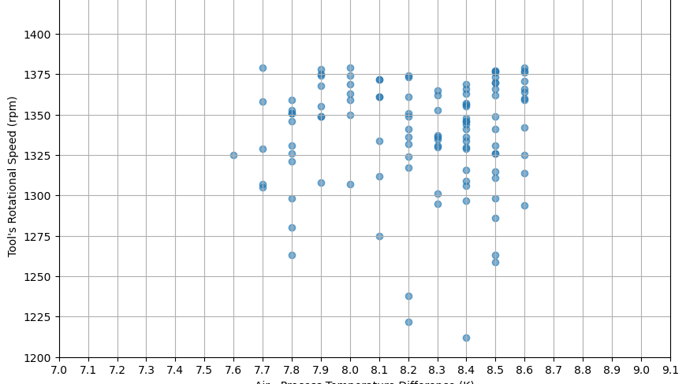

Slide 17

Overstrain failure analysis
The product of torque and tool wear gives us the strain.
if the product of tool wear and torque exceeds
11,000 minNm for the L product variant
12,000 for M,
13,000 for H the process fails due to overstrain. This is true for 98 datapoints.

Slide 18
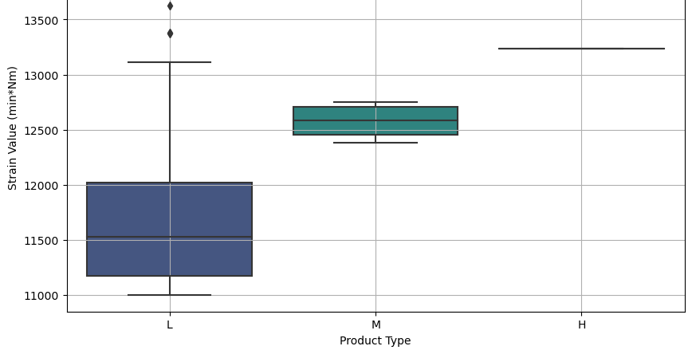

Slide 19
INDEPENDENT FAILURE MODES AND THEIR
1)tool wear failure (TWF): The tool will be replaced or fail at a randomly selected tool wear time between 200 – 240 mins (120 times in our dataset)
. 2. heat dissipation failure (HDF) heat dissipation causes a process failure, if the difference between air- and process temperature is below 8.6 K and the tool’s rotational speed is below 1380 rpm. This is the case for 115 data points.
3.)power failure (PWF) the product of torque and rotational speed (in rad/s) equals the power required for the process. If this power is below 3500 W or above 9000 W, the process fails, which is the case 95 times in our dataset.
4) overstrain failure (OSF) if the product of tool wear and torque exceeds 11,000 minNm for the L product variant (12,000 for M, 13,000 for H), the process fails due to overstrain. This is true for 98 datapoints.

Slide 20
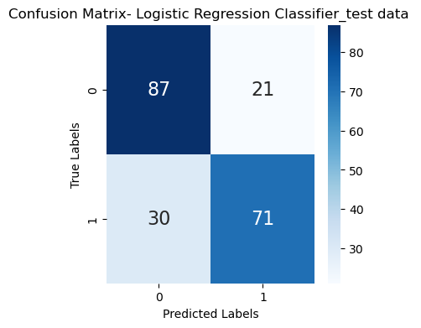
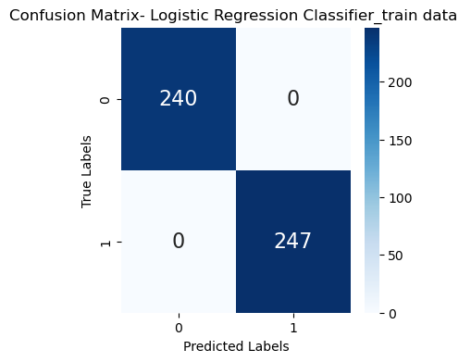
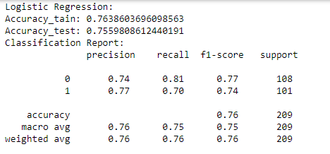
MODEL BUILDING
MODELS USED
Logistic Regression, Decision Tree.

Slide 21
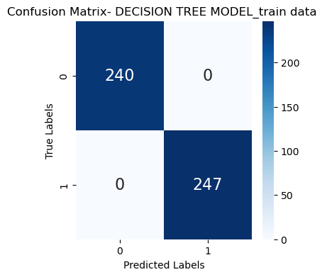
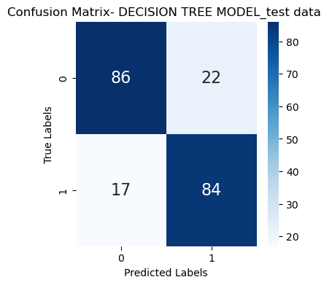
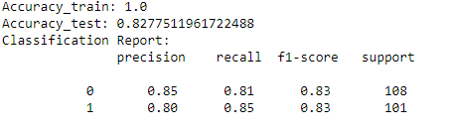
DECISION TREE MODEL

Slide 22
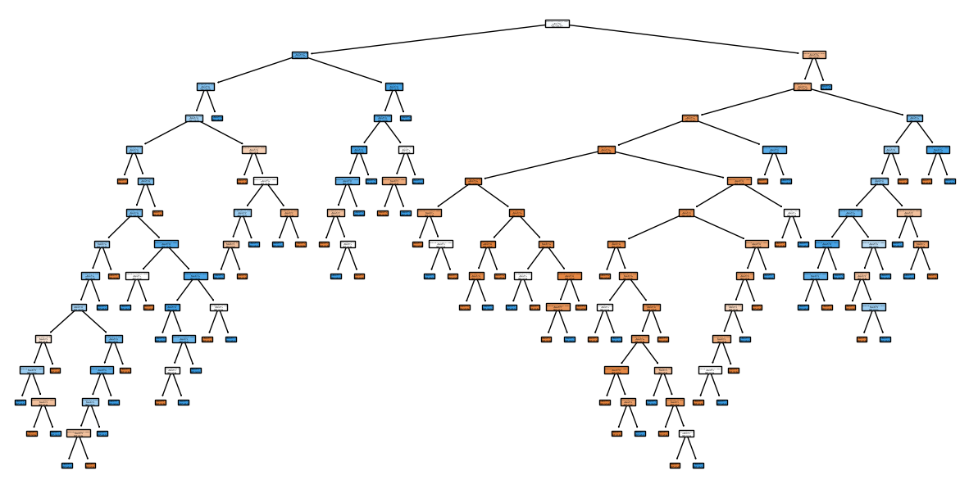
DECISION TREE MODEL

Slide 23
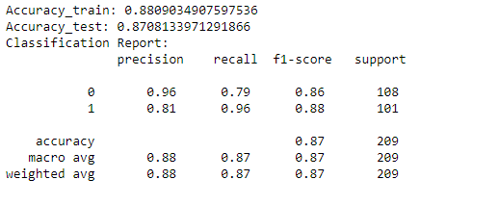
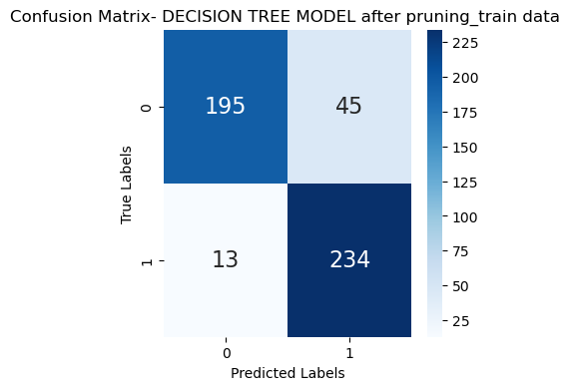
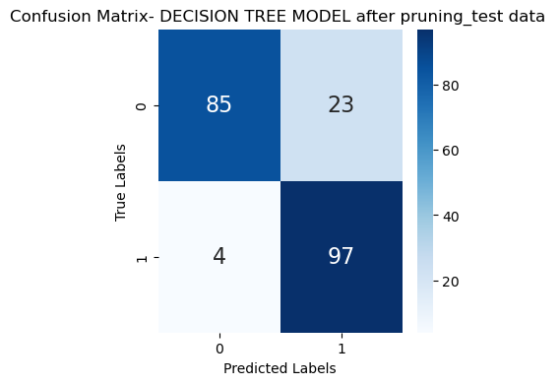
DECISION TREE USING 10 FOLD CROSS VALIDATION
Accuracy train:88%
Accuracy test: 87%

Slide 24
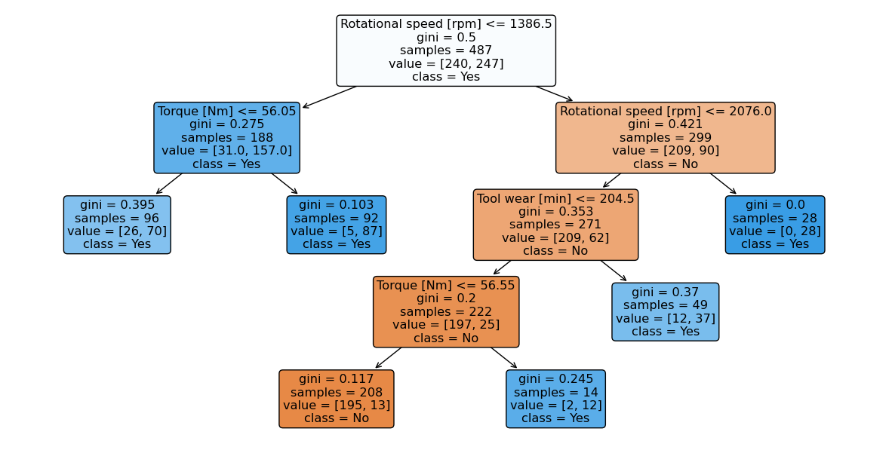
DECISION TREE USING 10 FOLD CROSS VALIDATION

